Slide 1
Calender Schedular Application
Task - 3

Slide 2
Calendar Schedular Application
Introduction : Revolutionize the way you manage your time by effortlessly planning events, setting reminders, and staying on top of your schedule. With a sleek interface and user-friendly design, organizing your life has never been this easy.
LMS Username | Name | Batch
Evangelin steffi J | J.Evangelin steffi | NM_2.0 CC3
Eniya.E | E.Eniya | NM_2.0 CC3
Anusiya.J | Anusiya.J | NM_2.0 CC3

Slide 3
Task 3 :: Frontend Creation
Create various Front End Programs
Draw and design a uniform front end code for Calendar Schedular Application.
Draw and design a interactive front end code for Calendar Schedular Application.
Evaluation Metric:
100% Completion of the above tasks
Learning outcome
Developing complicated UI using React components
Using props drilling and context to pass variables
Getting familiar with different type of api calls
Handling different input data

Slide 4
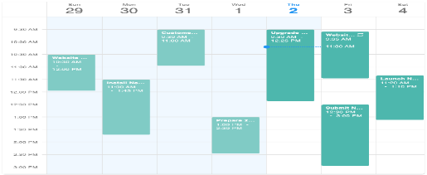


Step-Wise Description
1.We design a uniform and interactive front end code for Calendar Schedular Application using React.js
2. Using react components
Summary of your task
Using react components , We have succeeded to build a front end code and it works perfectly

Slide 5
Assessment Parameter
Create folder structure for HTML application
Render Conditional components
Write Functions for event handling
Check-List
Overall UI of the project
Use props to pass variables
Handling broken links
Use ApI calls for data
Optimizing render cycle

Slide 6
Submission Github
https://github.com/ENIYAELANG0/Naan-mudhalvan
https://github.com/Evangelinsteffi/Naan-muthalvan-
https://github.com/anusiya2003/Calenders-application

